Slide 1
Origins – Pop Music
Write down what you think pop music is...

Slide 2
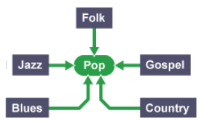
Origins – Pop Music
Pop music (abbreviated form of "popular music") is commercially recorded music, often aimed at towards young people, usually consisting of quite short and simple love songs and using technology.
Modern pop music has been influenced by many styles.

Slide 3
British pop music emerged in the 1950s. It was a style of
music which was seen as an alternative to American rock ‘n’ roll.
British pop music has changed a lot since the 1950s.
Over the years, more and more people have owned a radio or TV meaning that music has become more accessible for everyone.
Today, online platforms such as YouTube, SoundCloud and Spotify are making it even easier for artists to share their music and build an audience.

Slide 4
1960s The British Invasion
Two key styles emerged in this decade, which became part of the cultural phenomenon called the British invasion:
Beat music - guitar-dominated line-ups with vocal harmonies and catchy tunes. Key groups include The Beatles and The Kinks.
British blues - a new form of the American blues made using electric guitar. Key artists include The Rolling Stones, Eric Clapton and Fleetwood Mac.

Slide 5
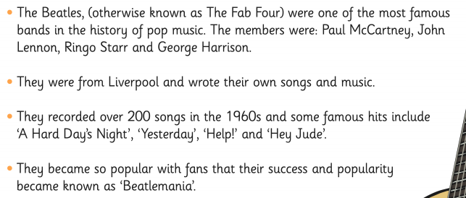
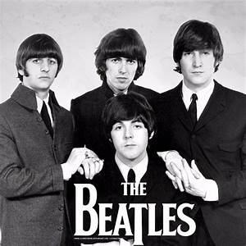
The Beatles

Slide 6
Let’s have a listen
What instruments can you hear?
How does the music make you feel?
Why do you think The Beatles were so successful?
How does their music compare to the music you listen to?
A Hard Day’s Night
https://www.youtube.com/watch?v=zx2TFk0vh1I&list=PLycVTiaj8OI-HjTjakWPpJO9Y6kh1icp2
Yesterday
https://www.youtube.com/watch?v=NrgmdOz227I
Help
https://www.youtube.com/watch?v=MKUex3fci5c
Hey Jude
https://www.youtube.com/watch?v=bkApuQWCPdM

Slide 7
1970s New Rock Music
The 1970s saw the rise of new rock genres. Here are some of them:
Glam rock - make-up, costumes and extravagant sets. Artists include David Bowie and Queen.
(Bohemian Rhapsody https://www.youtube.com/watch?v=fJ9rUzIMcZQ)
Ska - influenced by Reggae music. Artists include The Specials and Madness.
(Baggy Trousers https://www.youtube.com/watch?v=Dc3AovZgvo)
How is this music different to the 1960s music? What instruments can you hear?

Slide 8
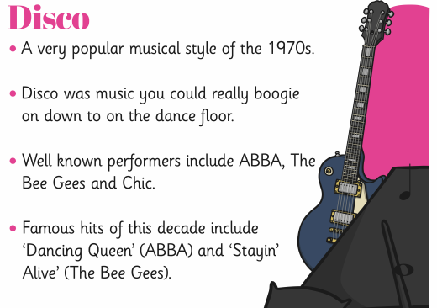
1970s Disco
Dancing Queen
https://www.youtube.com/watch?v=xFrGuyw1V8s
Staying Alive
https://www.youtube.com/watch?v=fNFzfwLM72c
Upbeat
Strong drum beat
Electric guitar
Bass guitar
Catchy melody

Slide 9
1980s Synth Pop
Pop music continued to change during the 1980s.
Synth pop - the evolution of electronic music technology using keyboards and drum machines. Key British artists included Eurythmics and Duran Duran.

Slide 10
1990s Boy Bands, Girl Groups and Britpop
Boy bands and girl groups such as Take That and The Spice Girls dominated the singles charts with a dance pop sound.
Soul music and world music revived an enthusiasm for folk.
Britpop - indie bands like Oasis, Blur and Pulp became popular in mainstream music, leading to the success of similar bands such as Coldplay and Snow Patrol.

Slide 11
2000s 21st Century
Some of the most successful artists include singer-songwriters who cover a variety of pop styles such as Ed Sheeran, Adele, James Blunt and Amy Winehouse.
UK grime emerged as a leading form of British rap with artists such as Stormzy building on the success of garage MCs Dizzee Rascal and Wiley.

Slide 12
Other useful resources
BBC Bitesize https://www.bbc.co.uk/bitesize/guides/z3q47p3/revision/7

